Slide 1

Data Champions Deep Dive Analytics on Graph Database | Friday, September 20

Slide 2
Morning
9:45 – 10:15 Knowledge and Knowledge Graph
10:30 – 11:00 Graph Databases
11:10 – 12:00
Stories, datasets and expectation for the afternoon
NeoDash
Afternoon -Flexible breaks-
13:00 – 14:00 Query graph database with Cypher
14:00 – 15:00 Build dashboards in NeoDash
Wrap-up 15:00 – 15:15

Slide 3
A few words about Neo4j presenters

Slide 4
A few words about me

Slide 5
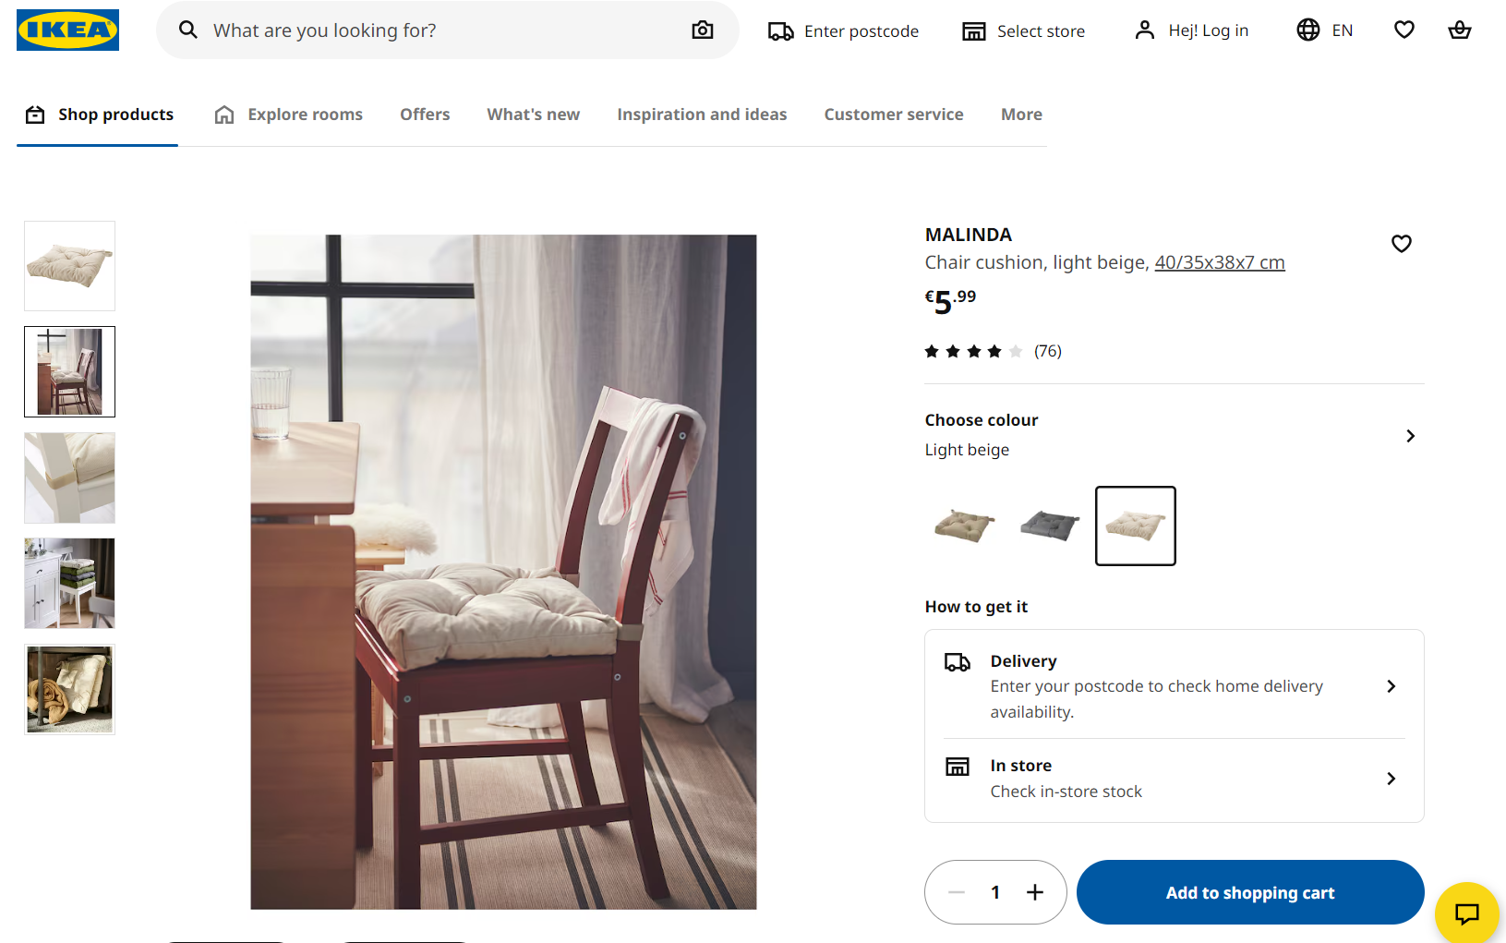
Product and Range
Notes:
I was working in the Product and Range Knowledge Domain
Transfer our IKEA HF knowledge to Customers

Slide 6
Agenda
9:45 – 10:15
Knowledge and Knowledge Graph

Slide 7
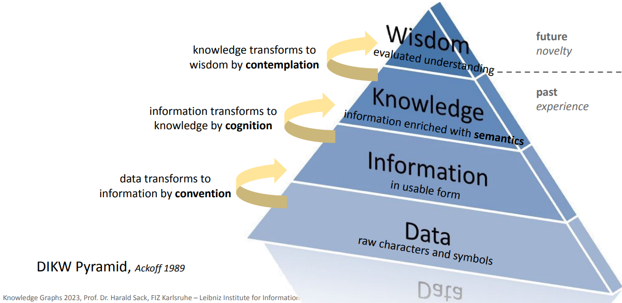
What is knowledge?
“Metadata” and “Knowledge” are interchangeable.
Knowledge is the appropriate collection of information, such that its intent is to be useful.
Information is data that has been given meaning by way of relational connection. Information answers to questions that begin with such words as who, what, when, where, and how many.
Data is raw. It simply exists and has no significance beyond its existence (in and of itself). It can exist in any form, usable or not.

Slide 8
Subject differentiates Knowledge Domains
Information
Subject: Product
Notes:
FAQ – “Knowledge Graph? Haven’t we already had it already? The one created by Inter IKEA.”
It is a Product and Home Furnishing Knowledge Graph. The audience is Customer.
As you can see here: The product is the subject. Product information: Name, type, color, size, price, material, key features, etc.
in a tabular format, are typically stored as columns. But they can be unstructured data, such as pictures.

Slide 9
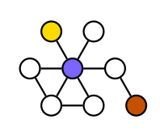
Subject differentiates Knowledge Domains
Column
Rules
Structure
Table
Definition
Format
Reference values
Product
Product colour
Coworker
Work email
Price
Size
Material
Entry date
Nationality
Gender
Definition
Structure
Format
Reference values
Rules
Notes:
What I’m working on is having these data as the subject, for example, Product Color. Its definition, organizing structure, type, format, reference value, rules, constraint, etc., all the information about the data stored in this column connected into the knowledge.
We often joke “metadata” of “metadata”. It’s actually “metadata” of “data”.

Slide 10
Subject differentiates Knowledge Domains
EMB model and schema
Metadata quality and compliance
Column
Rules
Structure
Table
Data quality and compliance
Definition
Format
Reference values
Cost center
Coworker
Code
Work email
Name
Entry date
Nationality
Parent cc
Gender
1 has 1
Definition
Structure
Format
Reference values
Rules
Notes:
What I’m working on is having these data as the subject, for example, Product Color. Its definition, organizing structure, type, format, reference value, rules, constraint, etc., all the information about the data stored in this column connected into the knowledge.
They are often referred as “metadata”.

Slide 11

Subject differentiates Knowledge Domains
Subject: Product Picture
Information
Resolution: 1920 x 1080 pixels
Date Taken: August 15, 2023
Time Taken: 10:30 AM
Location: Cozy Cottage, Elmwood Town, Fictionland
Camera Model: ImaginaryCam X200
Exposure Time: 1/125 sec
Aperture: f/2.8
ISO: 200
Products tagged: MALINDA chair cushion
Notes:
Previously the same picture is about how to use the product – MALINDA chair pad. Now the picture is the subject. The list of information is the metadata of this picture.
A photographer will love to have this information.

Slide 12
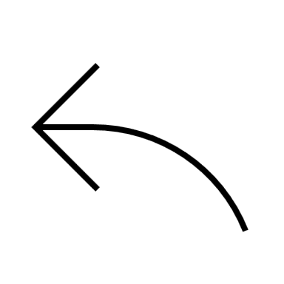
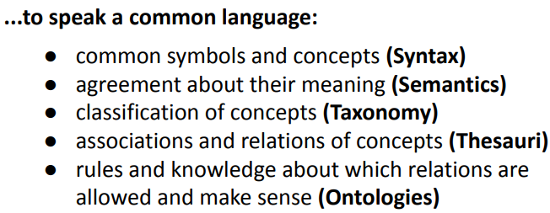
What is knowledge graph?
meaning of all concepts must be defined
machine understandable
consensus about ontology
Explicit, formal and shareable knowledge, leveraging graph technology.
People can’t share knowledge if they don’t speak a common language…

Slide 13
Why do knowledge and graph go hand-in-hand?
Connect data into information
Collect information into knowledge
New knowledge hooks upon previous knowledge (learning within and cross-domain)
Evolve (grow, update)
Relationship
Agility

Slide 14
The graph world
There are different technologies in the graph world. Let’s deep dive into how Neo4j does it.
--- Neo4j is the leader in …

Slide 15
Agenda
10:30 – 11:00
Graph Databases
What is graph database?
Why and when to use graph databases?

Slide 16
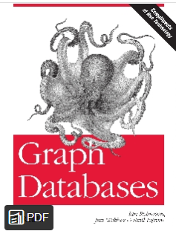
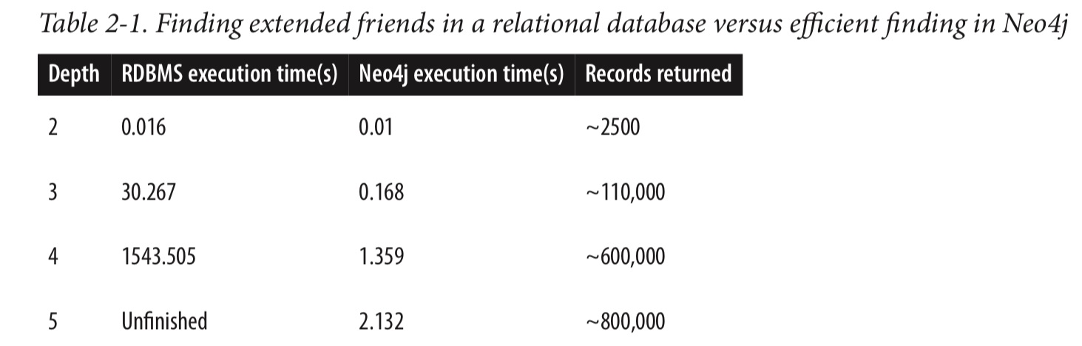
Graph databases vs Relational databases
When relationships are as important as entities, it’s time to use graph.
What are the advantages?
Intuitiveness
Agility
Naturally additive, without disturbing existing queries and application functionalities.
Performance

Slide 17
Graph databases
Example use cases outside of IKEA
Master data management
Customer 360
…

Slide 18
Agenda
11:10 – 12:00
Stories and datasets for today
Stories, datasets and expectations
Introduce NeoDash

Slide 19
What could be the graph use cases in IKEA world?
Product, Customer, People, Vendor, Location, Data (Product), Order Fulfilment …
They can be interconnected and reference one another for intended purposes.

Slide 20
Subject differentiates Knowledge Domains
Column
Rules
Structure
Table
Definition
Format
Reference values
Product
Product colour
Coworker
Work email
Entry date
Price
Size
Material
Gender
Nationality
Definition
contains
created by
Structure
Format
Reference values
Order
Rules
Notes:
In this session - Stories and datasets for today, we will demonstrate just that.

Slide 21
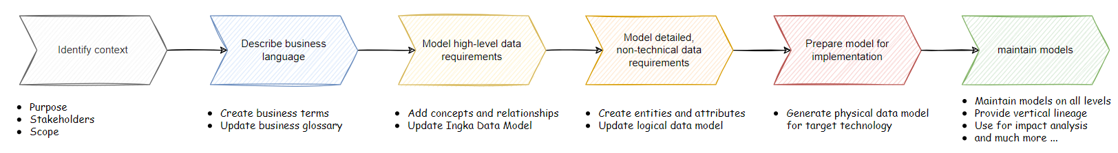
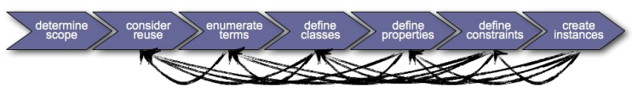
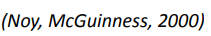
Development process comparison
Use data modeling process: Conceptual, Logical, Physical Data Models
Use ontology development process for knowledge graphs
Ontology development in practice is an iterative process that repeats continuously and improves the ontology.

Slide 22
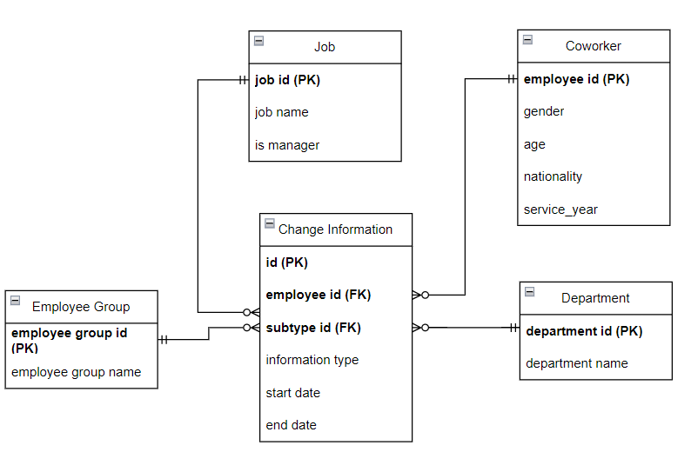
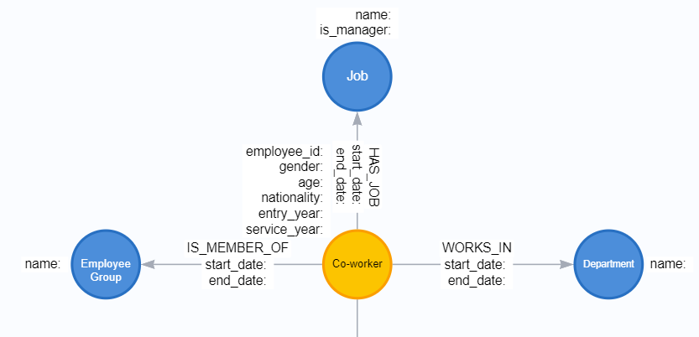
Development process comparison
Notes:
Graph vs relational, starting similar, implemented differently

Slide 23
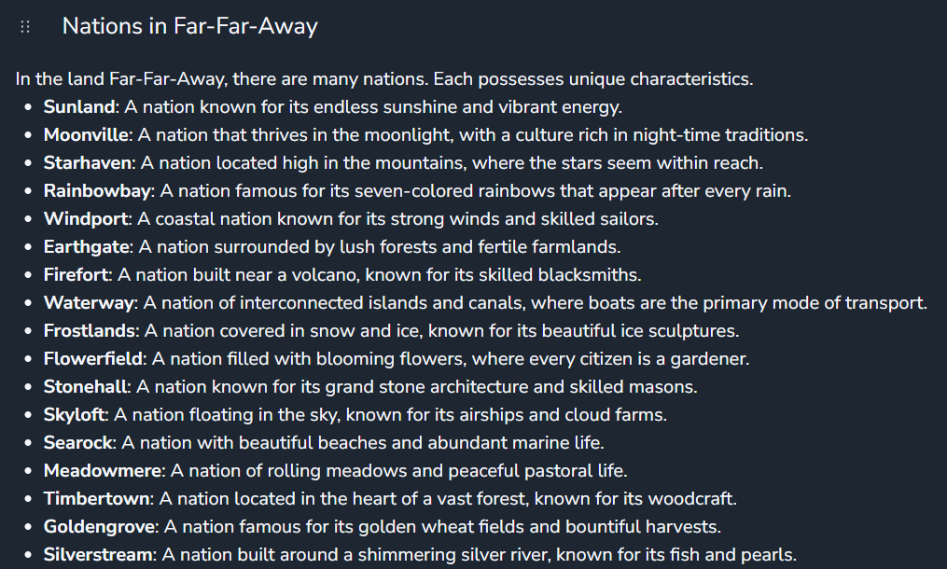
Story 1: Patterns in People Movement
In the land Far-Far-Away, there is a country called "Windport". In Windport, there is an IKEA store called "Fantastic", whose mission is to create better everyday life for the many people.
The mission is carried out by a group of dedicated coworkers with a mix of gender, nationality, age and service year. They commit to helping customers. In the meantime, they develop themselves in various ways.

Slide 24
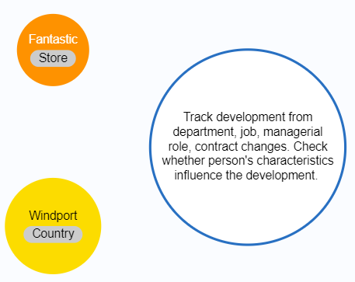
Data for Story 1
People Domain
Notes:
Comparing the distribution of the populations: All coworker, managers, coworkers having changes and see if the patterns change? Or are there any patterns? (Hint: pattern could mean bias)
In the event of a major org. transformation, many job titles were changed. How can we capture the realistic movement, excl. the impact of the transformation?

Slide 25

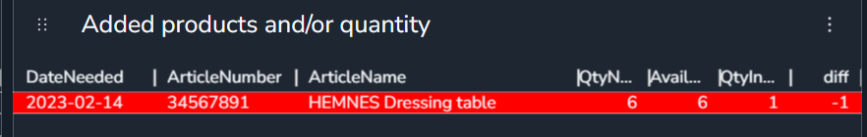
Story 2: Whether/when can the order be fulfilled?
On February 11, 2023. There were a few orders made in Store Fantastic. They were scheduled for delivery on February 12.
Life happens. Customer called and wanted to make the changes to the order. They could change delivery date, product and quantity.
Check if stock level can still fulfil the order after the changes.

Slide 26
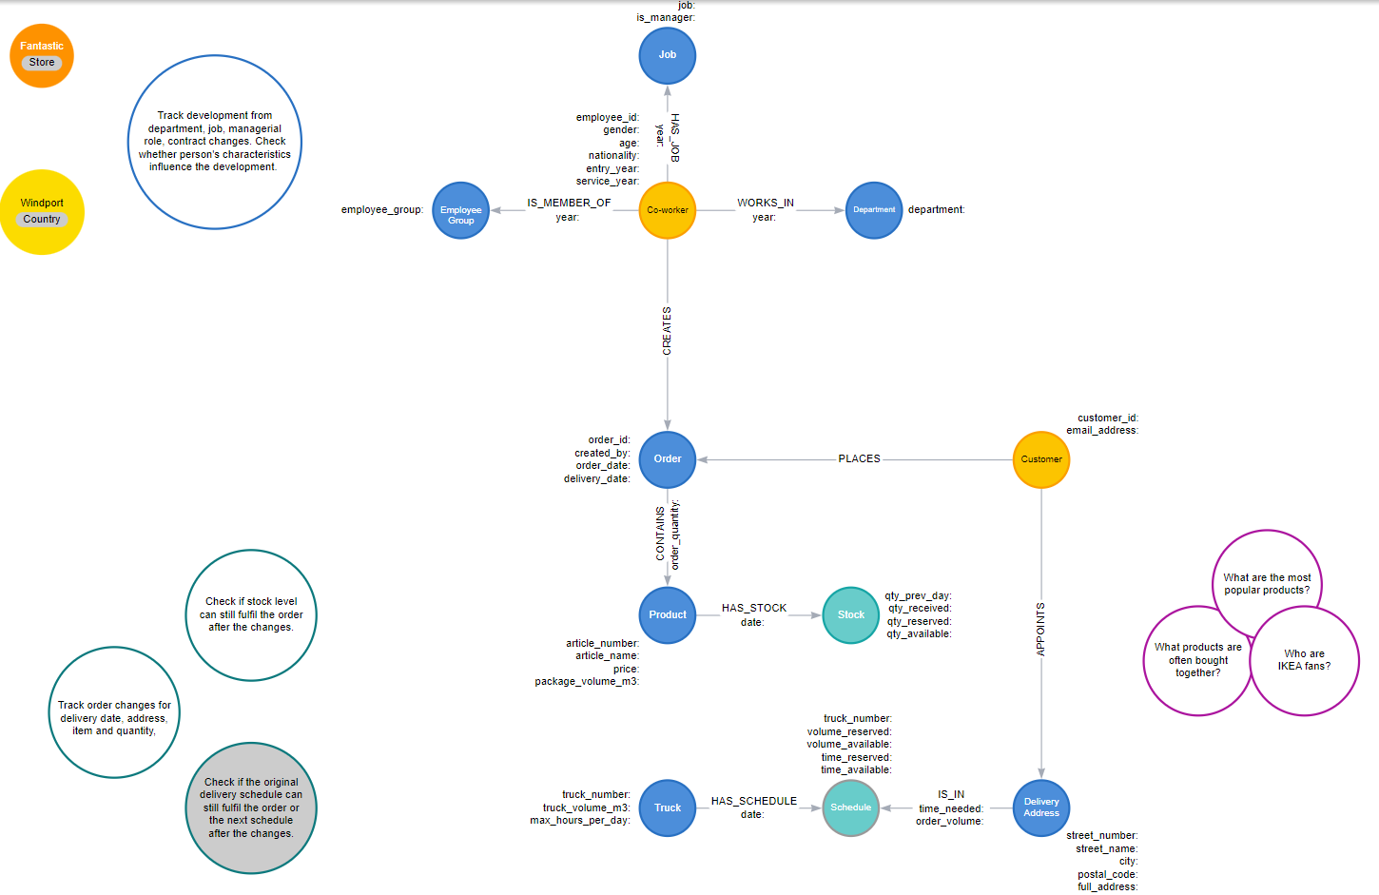
Data for Story 2
Story 2: “Can the order still be fulfilled?”
Order Fulfilment
Notes:
We will focus on 1 of the constraints: Stock. Check if we have stock to facilitate changes on delivery date, products, quantity of the products.

Slide 27
Data for Story 2
Video demo
Notes:
We will focus on 1 of the constraints: Stock. Check if we have stock to facilitate changes on delivery date, products, quantity of the products.

Slide 28



NeoDash and what it can do
NeoDash (UI)
NeoDash - Neo4j Dashboard Builder
NeoDash is an open-source tool for visualizing your Neo4j data. It lets you group visualizations together as dashboards and allow for interactions between reports.
Query
Visualize
Post changes
https://github.com/neo4j-labs/neodash
Ingka Data Knowledge Graph (DB)
Explicit, formal and shareable knowledge about data/ data products stored in a graph database

Slide 29
NeoDash and what it can do
Example of a semantic-rich knowledge graph can help itself curate the knowledge.
The knowledge graph can store embeddings.
It’s empowered by Graph Data Science Library. For example: to calculate cosine similarity with embeddings.
Relationship can be established with ONE line of code.
It can store metadata as the properties of the relationship for traceabilities.
Use NeoDash as an interface to enable human approval/reject of the relationship. (Swipe left/swipe right)

Slide 30
Afternoon
Hands-on workshop
13:00 – 14:00 Query graph database with Cypher
14:00 – 15:00 Build dashboards in NeoDash
Will you (or anyone you know) be interested in contributing to NeoDash – an opensource project?
Say hi to NeoDash community members
Potential Innersource Project with Ingka OSPO. We contribute together from Ingka!

Slide 31

Wrap-up
Thank you for participating!
Kudos to Neo4j team and Ingka Data Champions organizers!

